Slide 1
Predicting UK Road Accidents Severity using Machine Learning
Jainish Pasumarthi
SID- 14256112
Supervisor- Prof Darren Imrie

Slide 2
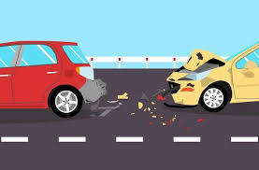
Introduction
Road traffic accidents are a major global concern, causing significant loss of life and economic impact, thereby, predicting the severity of these accidents can aid in proactive measures to enhance road safety.
Early identification of high-risk factors can help in implementing preventive measures.
Machine learning provides a data-driven approach to analyze and predict accident outcomes. These techniques utilize historical data on road accidents and able to make predictions on unseen data.
There are several factors influencing the decision such as vehicle type, road conditions, weather, driver behaviour, and more.

Slide 3
Problem Statement
High Rate of Road Accidents; Challenges in Road Safety
Lack of comprehensive dataset used in existing studies
Many existing studies are only predictive; Identification of high-risk factors before accidents occur can save lives
Always a scope of improvement by experimenting different set of ML techniques

Slide 4
Expected Impact
Impact on Public Safety and Traffic Management- The project enhances the ability of traffic authorities and emergency services to allocate resources more effectively, potentially reducing response times and improving outcomes for accident victims.
Data-Driven Decision Making- The identification of significant factors contributing to collision severity can inform policy-making and targeted interventions. For example, improving road infrastructure or enhancing vehicle safety features based on data-driven insights.
Public Awareness and Education- The project highlights how certain behaviours or conditions increase the risk of severe collisions. This can be used in public awareness campaigns to educate drivers about safe driving practices and the importance of vehicle maintenance.
Policy and Infrastructure Development- Understanding how different road types, conditions, and weather impact collision severity can guide infrastructure improvements, such as better road signage, improved lighting, or more rigorous road maintenance protocols.

Slide 5
Literature Review
Muguro et al.,2020 used Latent Dirichlet Allocation technique to predict the severity of Road accidents in Kenya. This study helped me in dataset selection. Authors emphasised the necessity of good quality dataset containing diverse features. Authors obtained the probabilities of 0.3534, 0.2773, 0.1803, and 0.1889 from topic 1 to 4 representing running over victim, hit-and-run, lost control, and head on collision.
Reverter Lopez (2021) helped me in understanding the importance of Data Cleaning and its impact on model performance. Author compared Random Forest technique and CART technique to predict severity of Barcelona Road Accidents. Author obtained the accuracy of 66% with Random Forest and 68% with CART technique.
Santos et al.,2022 inspired me to examine and compare the performance of several machine learning techniques on the same dataset in order to build accurate and robust machine learning classifier. They employed Random Forest, Support Vector Machine, Decision Trees, Bayesian Network, K-Nearest Neighbours and obtained maximum accuracy of 70% with Random Forest.
Reviewing other authors work strengthened my knowledge of machine learning and its predictive capabilities.

Slide 6
Research Gap
This study bridges the gap between previous study by specifically focus on Camden region of the UK which has not been done in the past.
Owing to their predictive capabilities other machine learning techniques have been experimented- Extreme Gradient Boost and CatBoost.
Assessed performance of four promising techniques on single dataset which has not been done in much studies.
Subjective along with predictive as it identifies several risk factors associated with UK Road Safety.

Slide 7

Research Question
How can machine learning algorithms be utilized to predict the severity of road collisions based on various factors such as vehicle type, road conditions, and driver demographics?

Slide 8
Objectives
The system is designed to predict road collision severity using a machine learning model integrated with a web-based user interface.
To obtain a comprehensive dataset for developing a machine learning based classifier.
To identify the factors playing crucial role in predicting the severity of accidents such as weather conditions, driver behaviour, etc.
To identify optimal machine learning techniques for handling predictive tasks with high accuracy.
To critically evaluate and compare the performance of different supervised machine learning techniques on same dataset.
To study and execute the integration process of ML model with user interface.

Slide 9
Requirements
Data Requirements
Historical Road Accident Data
Software Requirements
Python Programming Language
Libraries and Framework (ML Libraries, Flask for Web Application interface, Visualization Libraries, Joblib for saving ML model)
Integrated Development Environment (Visual Studio Code, Jupyter Notebook)
Hardware Requirements
Recommended Specifications – Intel i5 or higher processor, 8GB or higher RAM, 256GB or higher SSD for storage

Slide 10
Requirements
User Requirements
User-friendly web based interface (forms for inputting data)
Comprehensive user guides and documentation
Security Requirements
Data Security (Comply with GDPR)
Functional Requirements
Pre-processed Dataset
ML model with predictive capability
Important Risk Factors
Non-Functional Requirements
Accuracy
High-Performance
User-friendly

Slide 11
Design
Steps of design are-
Step-1: User enters encoded inputs on form
Step-2: Submit the form using Predict Severity button
Step-3: API request made to ML model for prediction
Step-4: ML model predicts Collision Severity based on input features
Step-5: Result displayed on the user interface

Slide 12
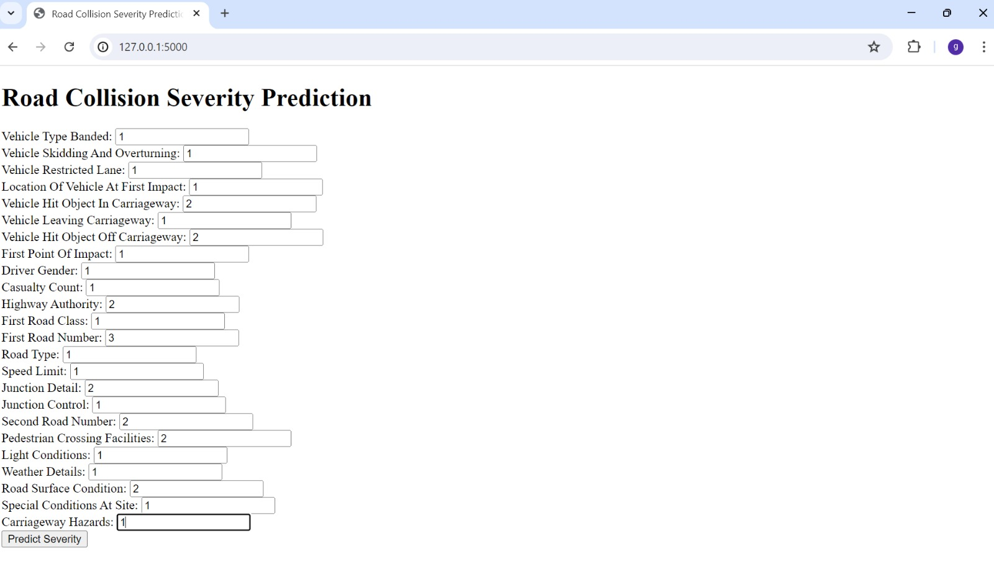
Form for user input

Slide 13

Form displaying Output

Slide 14
Project Management Methodology
Agile Framework
Utilize an Agile project management approach to ensure flexibility and continuous improvement.
Break down the project into manageable sprints with specific goals and deliverables.
Iterative Development
Develop the project in iterative cycles, allowing for regular evaluation and refinement.

Slide 15
Project Plan
Phase 1: Data Collection and Preprocessing (Weeks 1-3)
Gather historical accident data from reliable sources.
Clean and preprocess data, handling missing values and standardizing formats.
Phase 2: Feature Engineering and Selection (Weeks 4-5)
Identify relevant features influencing collision severity.
Transform and encode features for machine learning models.
Phase 3: Model Development (Weeks 6-8)
Train various machine learning models: Random Forest, Decision Trees, XGBoost, and CatBoost.
Evaluate models using metrics like accuracy, classification report, confusion matrix.
Phase 4: Model Evaluation and Selection (Weeks 9-10)
Compare model performances and select the best-performing model.
Optimize model parameters to enhance accuracy.
Phase 5: User Interface Development (Weeks 11-12)
Design and develop a user-friendly web interface.
Integrate the selected model to provide real-time predictions.
Phase 6: Testing and Deployment (Weeks 13-14)
Conduct thorough testing of the model and interface.
Deploy the application and ensure it is accessible to users.
Phase 7: Documentation and Reporting (Weeks 15-16)
Document the project methodology, findings, and recommendations.
Prepare and present the final project report and user guide.

Slide 16
Dataset Description
Since Machine Learning models require comprehensive dataset having significant number of features and records for training purposes, thus several sources have been scanned to obtain the desired dataset.
Key considerations which lead to selecting the dataset
Publicly Available (Not from Kaggle or UCI)
Volume (Large number of records)
Variety (Diverse features)
The dataset used in this study comprises of 48 features and approximately 11,000 records. However, source states to use only latest 3 years data making the row count to nearly 2600.
Dataset comprises of numerous features illustrating the weather conditions, road conditions (Speed Limit, Junction, Carriageway, etc), driver behaviour (gender, age band), and many more.
The target variable (Collision Severity) can be classified into three categories namely- Slight, Serious, Fatal.
During data analysis, Class Imbalance has been identified which might lead to bias decision making, thus handled using SMOTE technique.
Source of the dataset is- https://opendata.camden.gov.uk/Transport/Road-Collision-Vehicles-In-Camden/ukwp-nh45/about_data

Slide 17
Implementation-ML Techniques
Random Forest: Chosen for its robustness and ability to handle large datasets with high dimensionality, providing strong performance through ensemble learning.
Decision Trees: Selected for their simplicity and interpretability, making it easy to understand the decision-making process and identify important features.
XGBoost: Chosen for its exceptional performance in many machine learning competitions, offering high accuracy and efficiency through gradient boosting.
CatBoost: Selected for its effectiveness with categorical data, reducing the need for extensive preprocessing and delivering high performance with minimal tuning.

Slide 18
Tools and Technologies
Programming Languages:
Python for model development and data processing.
HTML/CSS for web interface development.
Libraries and Frameworks:
Scikit-learn, XGBoost, CatBoost for machine learning.
Flask for web application development.

Slide 19
Methodology Adopted
Data Collection
Data Pre-processing
Data Cleaning
Data Transformation
Feature Engineering
Model Development
Algorithm Selection
Model Training (70/30 Split)
Model Evaluation
Model Selection
Performance Comparison
Feature Importance
Model Deployment
UI development
Integrating ML model with UI
System Testing and Validation
By following these steps, the project aims to provide valuable insights and tools to enhance road safety measures.

Slide 20
Testing
This phase ensures that all the requirements of the study are met such as accuracy of machine learning model and the web application function.
Testing Stages-
1. Data Integrity Check
2. Data Validation
3. Model Evaluation using Confusion Matrix and Classification Report
4. User Interface Test (Test it with different set of inputs)

Slide 21
Results
Implemented ML techniques have been evaluated using Confusion Matrix and Classification Report. The comparison of classification report for each technique is given below:
ML Techniques | Accuracy | Precision | Recall | F1 Score
Random Forest | 96.05% | 96% | 96% | 96%
Decision Trees | 91.26% | 91% | 91% | 91%
XG Boost | 95.31% | 95% | 95% | 95%
CatBoost | 95.11% | 95% | 95% | 95%
Classification Report Comparison
Risk Factors identified- Road Type, Junction Detail, Vehicle Type, Road Surface Condition, Pedestrian Crossing Facilities, Light Conditions

Slide 22
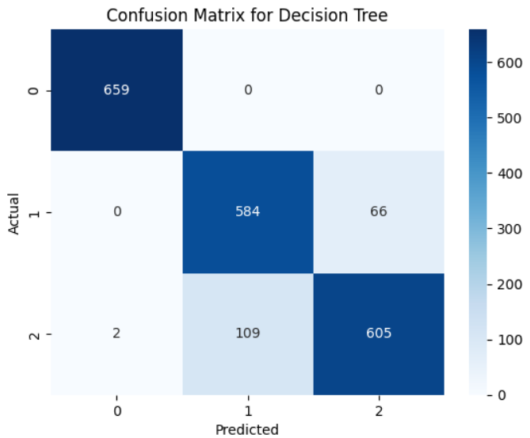
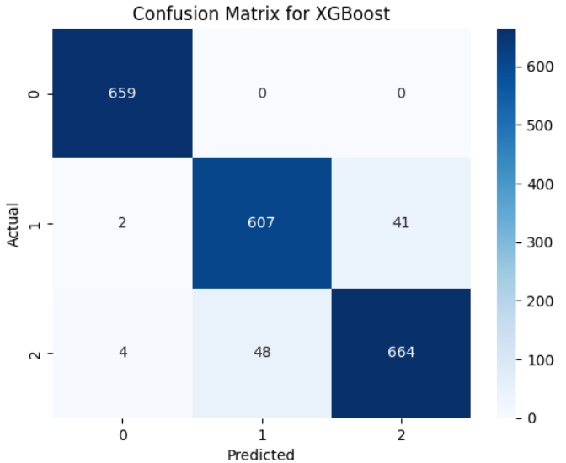
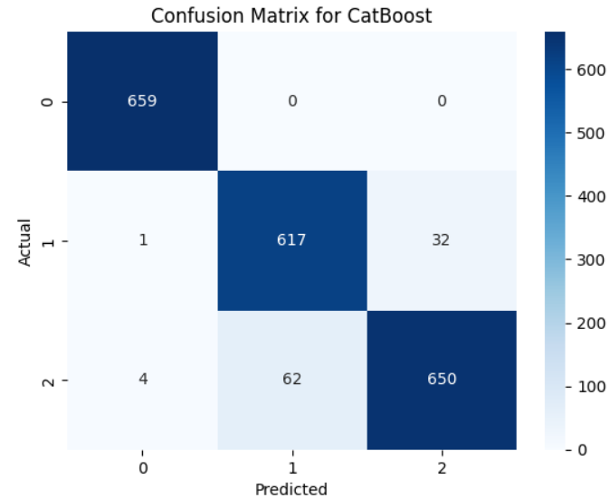
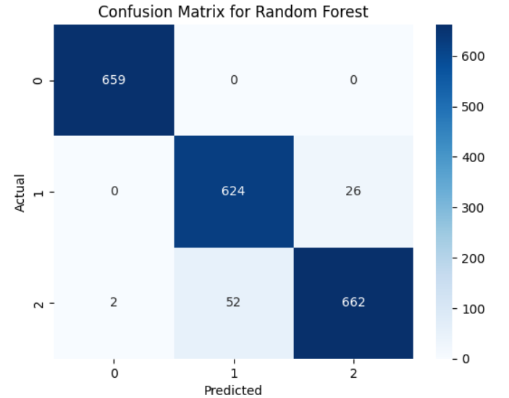
Results
Above images show the confusion matrix obtained for each of the implemented technique. It is evident from the images that Random Forest technique classified the maximum number of observations correctly.

Slide 23
Discussion
This research work is based on understanding the role of machine learning in predicting the UK Road Traffic Accidents.
Among all the four techniques, Random Forest yielded the highest accuracy of 96%, reflecting the effectiveness of ML in predictive modelling.
The results of the should not be compared with the work of previous authors since all the works are done on different set of features.

Slide 24
Conclusion
Project Achievements-
Developed a ML classifier
Developed a user-friendly web based interface for real-time predictions
Key Findings-
Random Forest outperformed other techniques with the accuracy of 96%
Critical Features identified
Impact-
Supports decision-making for traffic authorities and emergency responders
Enhances road safety by identifying risk factors
Future Directions-
Explore additional techniques and feature sets to improve model performance
Expand user interface functionalities and integrate with real-time applications related to traffic management
The project effectively contributes to safer road environments through predictive analytics and real-time insights.

Slide 25
References
Muguro, J. K., Sasaki, M., Matsushita, K., & Njeri, W. (2020). Trend analysis and fatality causes in Kenyan roads: A review of road traffic accident data between 2015 and 2020. Cogent Engineering, 7(1), 1797981.
Reverter Lopez, E. (2021). Predicting the severity of road traffic accidents in the city of Barcelona (Bachelor's thesis, Universitat Politècnica de Catalunya).
Santos, K., Dias, J. P., & Amado, C. (2022). A literature review of machine learning algorithms for crash injury severity prediction. Journal of safety research, 80, 254-269.

